Slide 1
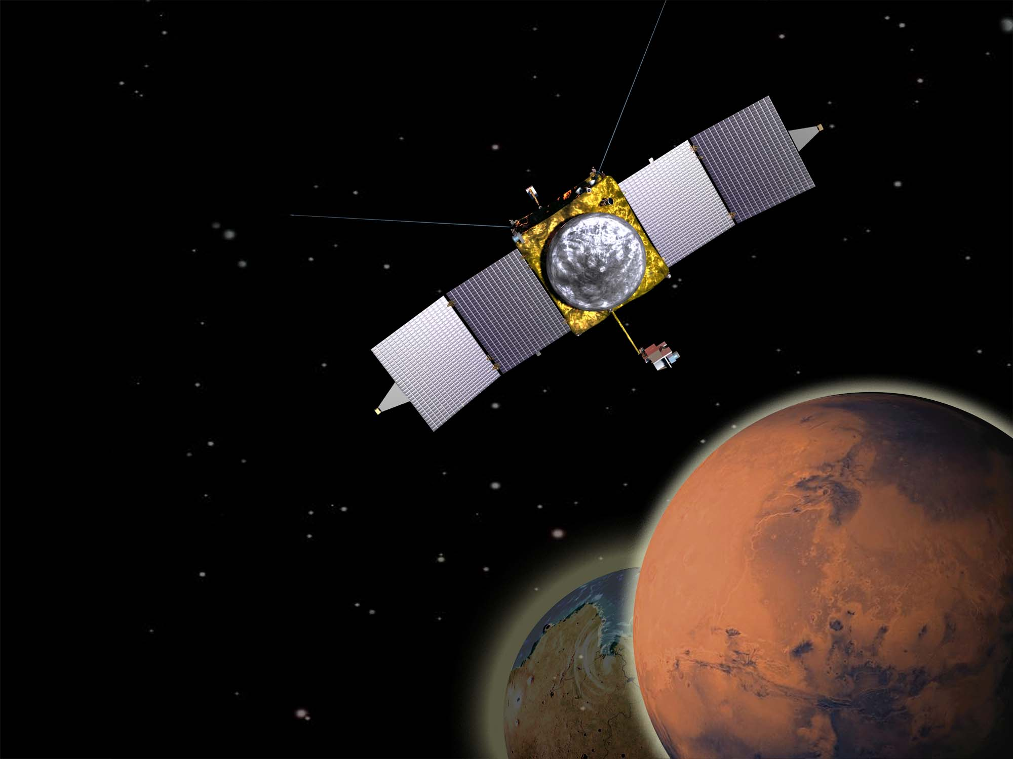
Exploring Mars’
Climate History

Slide 2
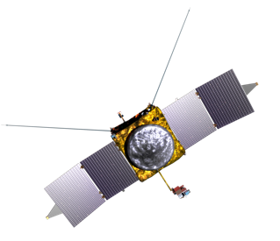
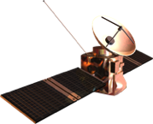
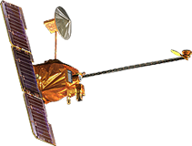
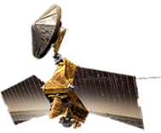
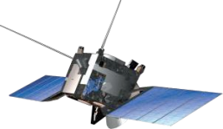
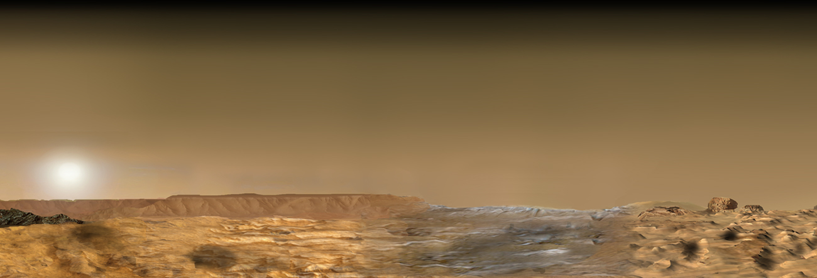
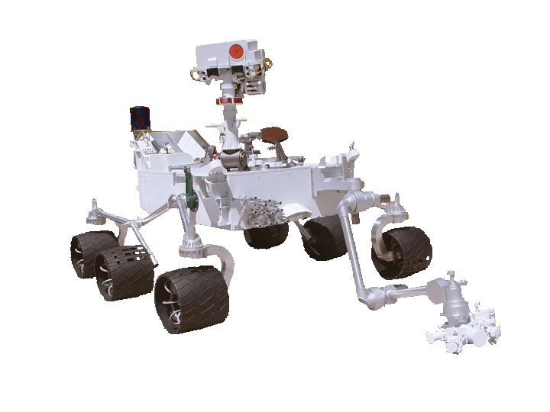
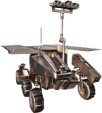
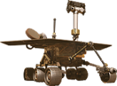
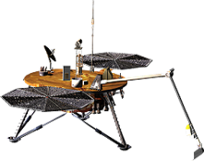
Current & Future Mars Missions
Operational
2013
2016
2018
2020
2022
2001 - 2012
Mars
Reconnaissance
Orbiter
Mars Odyssey
MAVEN Aeronomy Orbiter
ESA Trace Gas Orbiter
(NASA: Electra)
ESA Mars Express
(NASA: MARSIS)
Follow the Water
Habitable Environments
Seeking Signs of Life
Future
Opportunity –
Mars Exploration
Rover
Curiosity –
Mars Science Laboratory
InSight
ESA
ExoMars Rover
(NASA: MOMA)
2020
Science Rover
Notes:
Image Credit/Source: NASA/JPL-Caltech
Speaker’s Notes: this slide does not show all missions in the Mars Exploration Program. At left are currently operating missions. At right are future Mars missions. ESA stands for the European Space Agency. The US has a role in each of these missions, either through instrument contributions or technical support (e.g., navigation and communications with Earth).

Slide 3
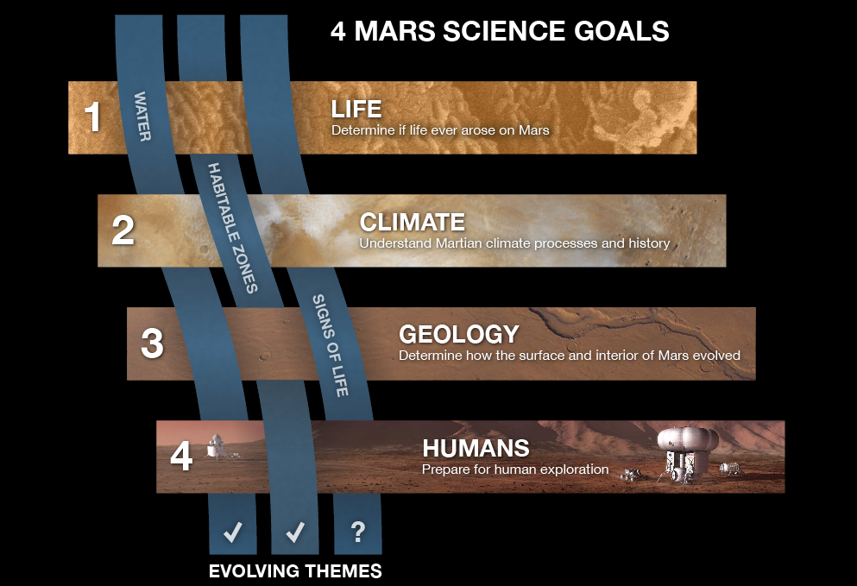
Mars missions contribute to key science goals and themes.
Notes:
Image Source: NASA/JPL-Caltech
Speaker’s Notes: In the first stage of Mars Exploration, NASA missions focused on “following the water” – seeking signs of past or present water on Mars. Water is key to life as we know it. Mar rover Sojourner studied an ancient flood plain. Orbiters (Mars Global Surveyor, Odyssey, and Mars Reconnaissance Orbiter) contributed findings about past water on Mars, current subsurface water-ice, and surface changes that might indicate some short-term active water flows etc. The Phoenix Mars lander was the first to touch water ice on Mars. These missions all began identifying habitable zones, with Mars rover Curiosity sent specifically to understand Gale Crater as a potential past habitable environment – not just with water, but seeking chemicals necessary to life as we know it, including signs of organics – the chemical building blocks of life. MAVEN is a key part of understanding Mars as a potential habitat, given its important role in determining the climate history of Mars – including when and how long Mars might have had an environment more favorable to life in ancient times. While Mars rover Curiosity cannot detect life, it is on the cusp of the next phase of exploration: seeking signs of life. The proposed Mars 2020 rover, based on Curiosity’s design but with different instruments, would take the first steps toward seeking signs of life itself, linking back to early attempts to do so by the Viking landers. The Mars 2020 rovers would seek 5 of 6 types of potential biosignatures, and prepare a cache for future potential sample return to earth, where all 6 potential biosignatures could be tested in Earth-based laboratories, depending on the samples collected and returned. All of the reconnaissance related to the Martian environment – its resources and potential environmental hazards to human health – and critical technology developments also paves the way for eventual human exploration, a long-term national exploration strategy.

Slide 4
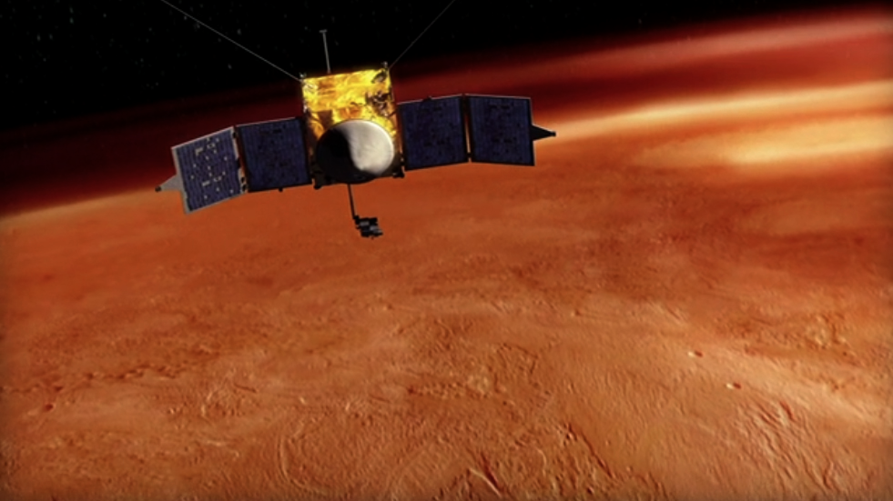
MAVEN will study Mars’ upper atmosphere
and determine how it interacts with our Sun.
Notes:
IMAGE SOURCE: NASA/GSFC/LASP
http://www.nasa.gov/images/content/486126main_mavenorbitfull.jpg

Slide 5
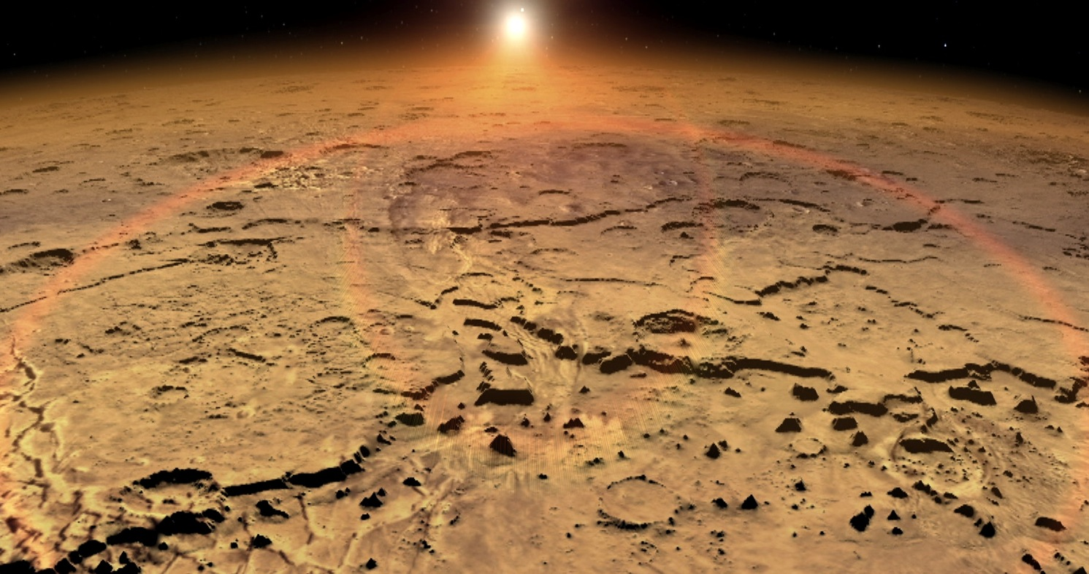
We will learn how Mars lost
most of its atmosphere and water to space,
making today’s Martian climate challenging for life.
Notes:
IMAGE SOURCE: NASA/GSFC/LASP
(Still from NASA/GSFC MAVEN Video)

Slide 6
The Martian atmosphere today is very thin,
so surface pressure is very low (1% of Earth’s).
Long-lasting surface water is no longer possible.
Notes:
IMAGE SOURCE: NASA/JPL-Caltech/Cornell
Speaker’s Note: Scene from Mars Rover Opportunity., with clouds above and ripples of Martian “soil” (regolith) below.

Slide 7
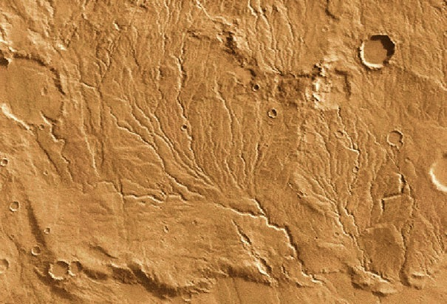
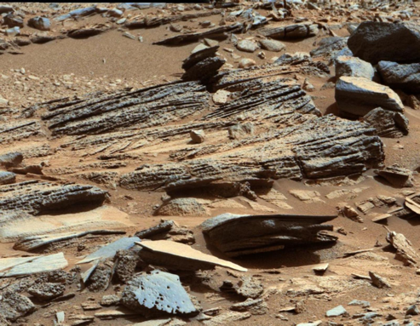
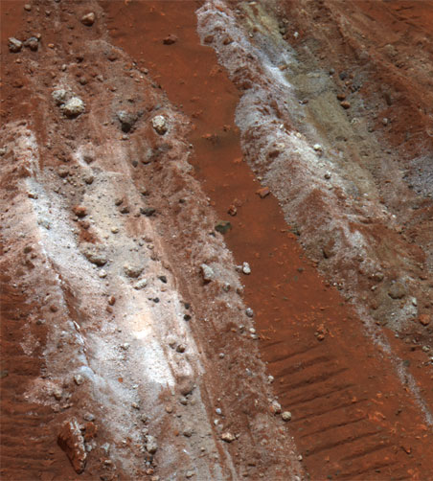
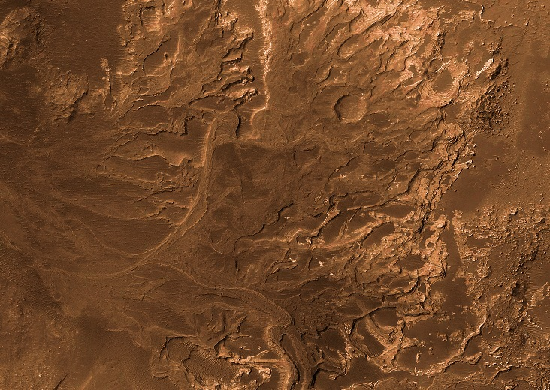
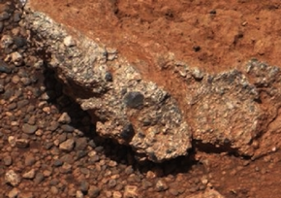
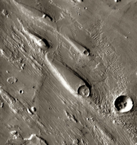
Yet, Mars has abundant evidence for ancient water!
(outflow channels, deltas, sedimentary and conglomerate rocks, salts, minerals that form in water etc.)
Notes:
IMAGE SOURCES:
http://www.rmg.co.uk/server/show/conMediaFile.17244 http://solarsystem.nasa.gov/multimedia/gallery/Mars_2003.11.13a_100_732X520.jpg
http://www.jpl.nasa.gov/spaceimages/images/largesize/PIA13653_hires.jpg
http://www.jpl.nasa.gov/spaceimages/images/wallpaper/PIA16707-1600x1200.jpg
http://marsrovers.jpl.nasa.gov/gallery/press/spirit/20070628a/Sol1198A_P2539_L257F_br.jpg
Speakers Notes: Large-scale features suggest the presence of long-term water, as do surface features such as sedimentary layers and minerals that typically form in, or are altered by, water.

Slide 8
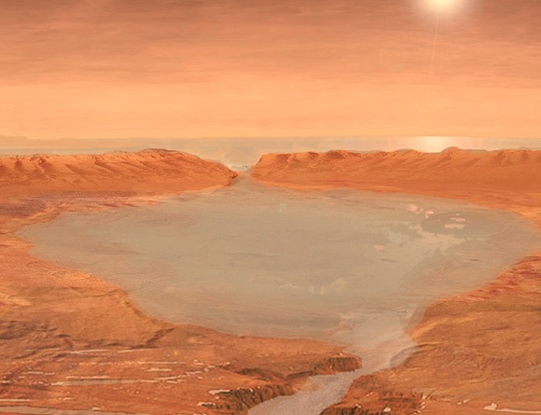
That means early Mars likely had a dense, thick atmosphere, which helped keep Mars warmer and wetter.
Notes:
IMAGE SOURCE: Artist’s Concept. NASA/JPL-Caltech

Slide 9
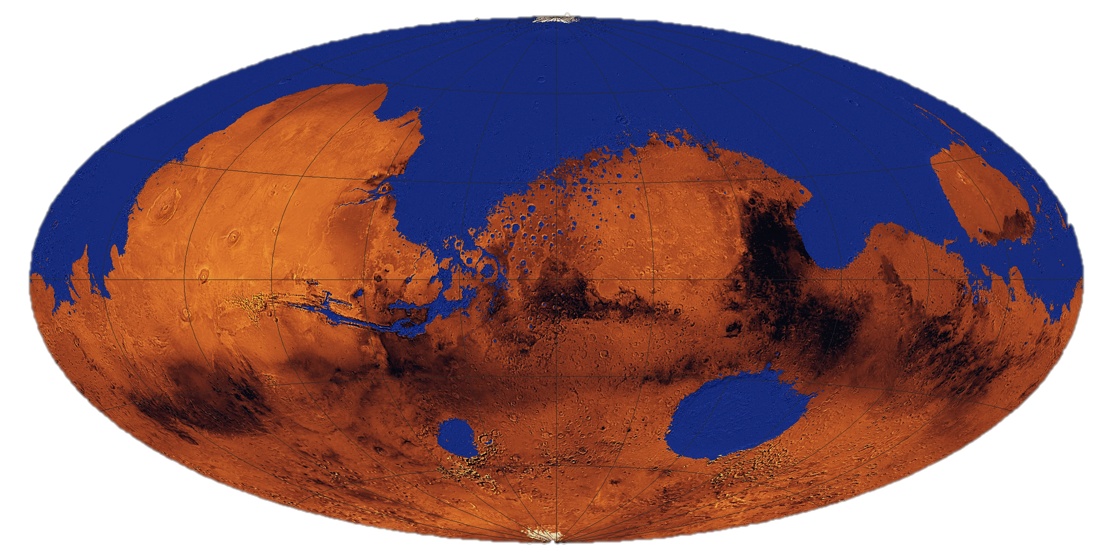
Early Mars may have even had a global ocean.
Water is necessary for life as we know it, along with
carbon-based and other chemicals life needs to thrive.
Notes:
IMAGE SOURCE:
http://lasp.colorado.edu/home/wp-content/uploads/2010/08/Mars_global_ocean.jpg

Slide 10
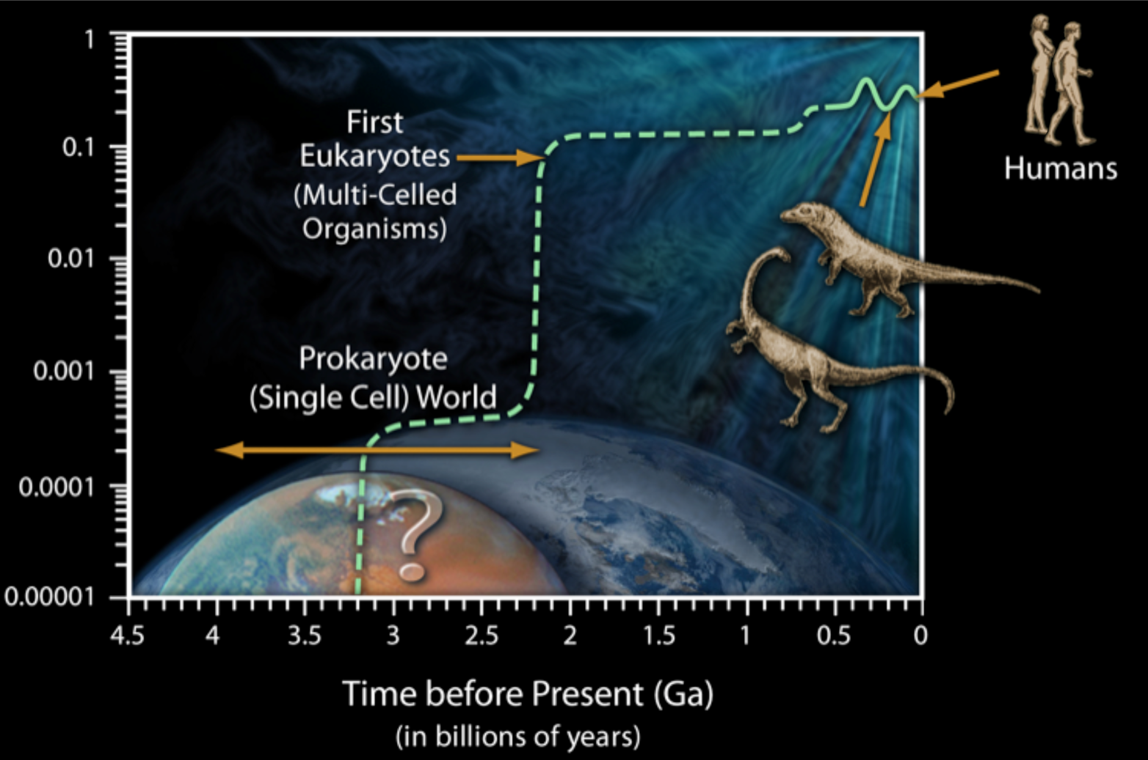
Over 3 billion years ago, simple, microbial life
was on Earth. How about on Mars?
+ Diversity of Life
Level of oxygen
In the atmosphere
Notes:
IMAGE SOURCE: NASA/JPL-Caltech
Speaker’s Notes: This chart shows that the environment of Mars may have been more similar to that of Earth earlier in its history. On Earth, we find the earliest signs of microbial (single celled) life dating to about 3.5 billion years ago. Could it have existed on Mars? On Earth, multicellular organisms only became possible once there was enough oxygen in the atmosphere. Oxygen likes to bind with other elements, so it takes a lot before there is enough free oxygen in the atmosphere to help support life’s processes. Early microbial communities produced oxygen as a biproduct, thus altering Earth’s environment enough to support higher life forms. That is not true for Mars. So, we would not expect to find “little green men” or signs of other higher level creatures. Any past life on Mars would have been microbial.

Slide 11
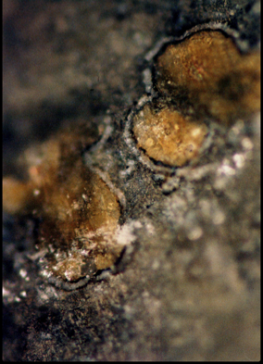
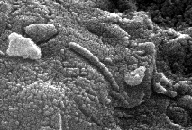
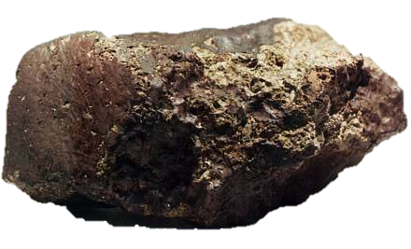
We don’t yet know if early Mars ever had microbial life.
METEORITE FROM MARS:
ALH84001
BLASTED INTO SPACE BY A LARGE IMPACT
TRAVELED TO EARTH & LANDED IN ANTARCTICA
SIGNS OF LIFE?
Notes:
IMAGE Credit/Source: NASA
Speaker’s Notes: In addition to providing some interesting and controversial features related to life, meteorites provide a record of Mars from ancient times. Ancient atmosphere trapped in bubbles within the meteorite provide an indication of the atmosphere when the rocks were blasted from the surface of Mars and sent hurling into space. The magnetism of a special class of Martian meteorites known as SNCs (shergottite, nakhlite, chassignite) can also indicate the magnetic fields that were present at the time of ejection. ALH84001 is an SNC meteorite.
More info on ALH84001:
--found in Antarctica in 1984
--was likely ejected from Mars about 15 million years ago
--based on chemical analysis, may have formed at a time when Mars had water on its surface; it is the only known Martian meteorite from this period
--carbonates possibly formed when a subsurface body of water slowly evaporated
--carbonate globules thought by some to be microscopic fossils of Martian microbes
--however, they were extremely small – 20-100 nanometers – smaller than any known cellular life
--findings sparked worldwide interest and controversy; some features were later recreated in lab without life as part of the process
--still a mystery, but most agree that one can’t judge by the shape of features alone

Slide 12
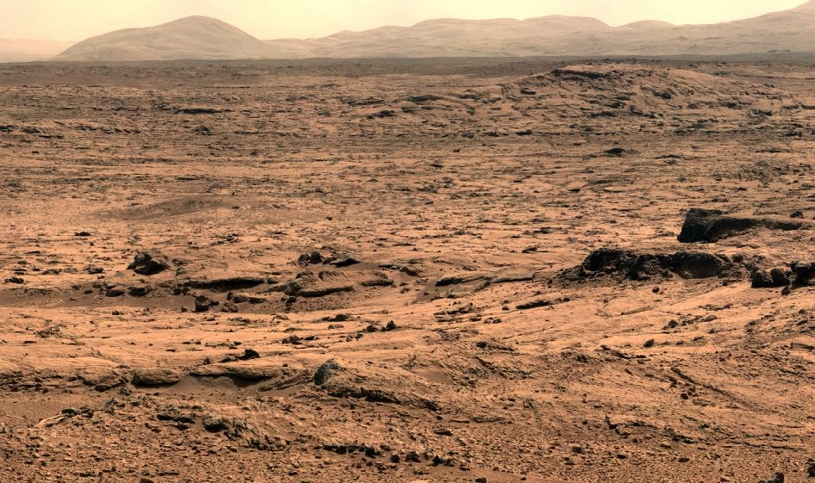
We don’t know exactly how habitable conditions
on Mars changed over time – or how long they lasted.
Notes:
IMAGE Credit: NASA/JPL-Caltech/MSSS
Speaker’s Notes:
An Ancient Habitable Environment at Yellowknife Bay (Mars Rover Curiosity)
The regional geology and fine-grained rock suggest that the John Klein site was at the end of an ancient river system or within an intermittently wet lake bed
The mineralogy indicates sustained interaction with liquid water that was not too acidic or alkaline, and low salinity. Further, conditions were not strongly oxidizing.
Key chemical ingredients for life are present, such as carbon, hydrogen, oxygen, phosphorus, and sulfur
The presence of minerals in various states of oxidation would provide a source of energy for primitive organisms

Slide 13
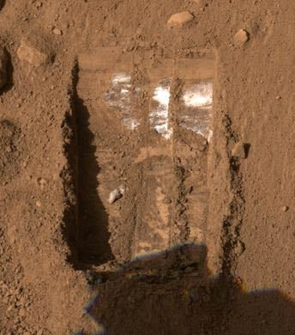
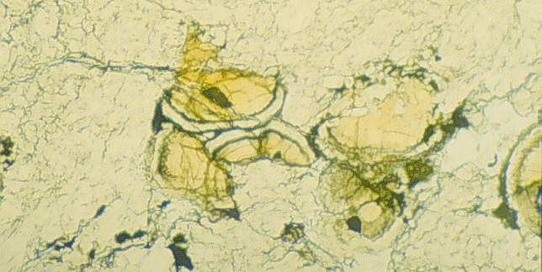
OPTION 1: DOWN Underground or in the rock record? Yes, but not enough to account for the loss.
MAVEN’s Mystery to Solve: Where Did All of the Water & CO₂ Go?
SUBSURFACE: Water Ice
CRUST: Carbonate deposits in a Martian meteorite
Notes:
Image Credits: NASA/JPL-Caltech/University of Arizona (left); LPI/Alan Treiman (right)
Speaker’s Notes:
The Phoenix Mars lander scooped beneath the Martian surface and became the first “to touch” water ice on Mars. Some water in the form of water-ice exists in the Martian subsurface, and has not been lost to space.
Carbonate globules in ALH84001 are the yellow/orange features at center, and are surrounded by lighter material (orthopyroxene) and small dark grains (chromite). Field of view: ~t 0.5 millimeters across. Water that soaked the rock long ago likely deposited the carbonates. Carbonates may be one indicator for how some of the carbon dioxide was removed from the martian atmosphere, trapped, and stored in Martian rocks as opposed to lost to space. Rovers and orbiters have found carbonates in the rock record on Mars. For example, Mars rover “Spirit” found that the “Comanche” outcrop may be up to ¼ carbonates.
Finding carbonate minerals on Mars is also important because they dissolve in acidic water. Their presence means that the past watery conditions were likely more neutral, and thus more favorable to life, if any existed.

Slide 14
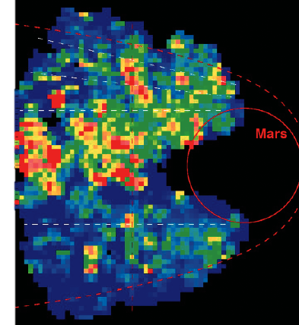
MAVEN’s Mystery to Solve: Where Did All of the Water & CO₂ Go?
OPTION 2:
UP
Lost to Space
Escaping ions detected
by the Mars Express orbiter
Notes:
Credit: ESA

Slide 15
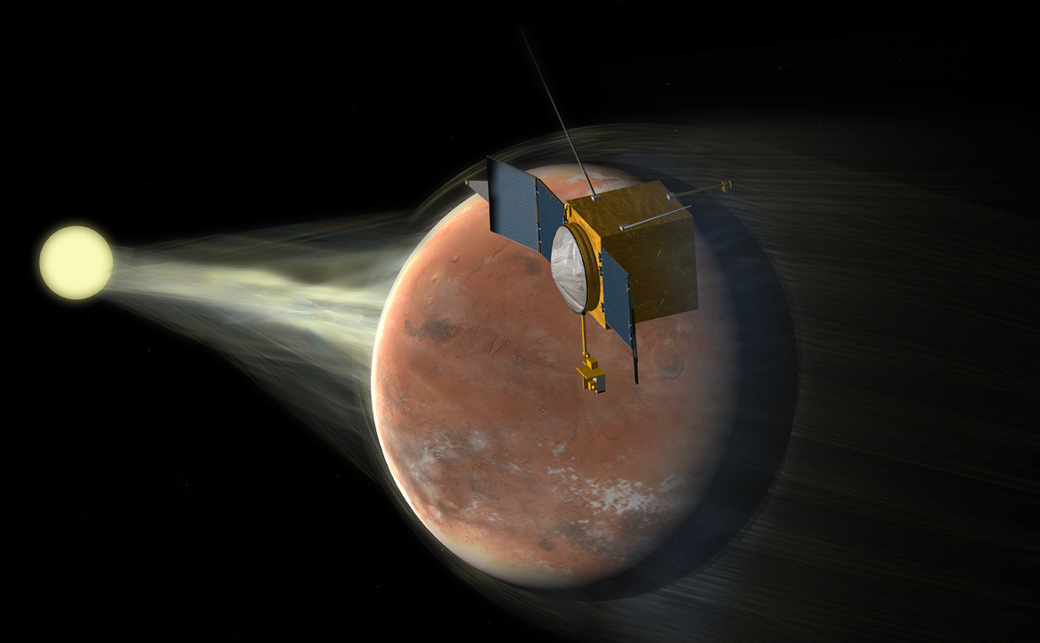
MAVEN will find out how the Martian environment
radically changed by studying the solar wind
and other interactions with the Sun.
Notes:
IMAGE SOURCE: NASA/JPL-Caltech/LASP
Artist’s concept.

Slide 16
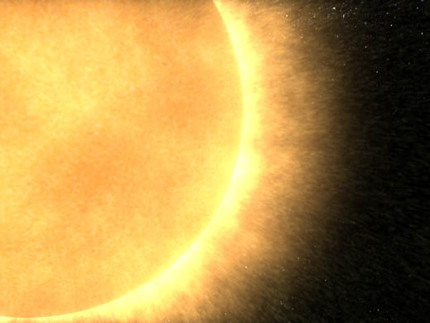
The solar wind is
a high-speed stream of
electrons and protons
released from the Sun.
Notes:
IMAGE SOURCE: NASA/GSFC
http://www.nasa.gov/centers/goddard/images/content/96516main_still1web.jpg

Slide 17
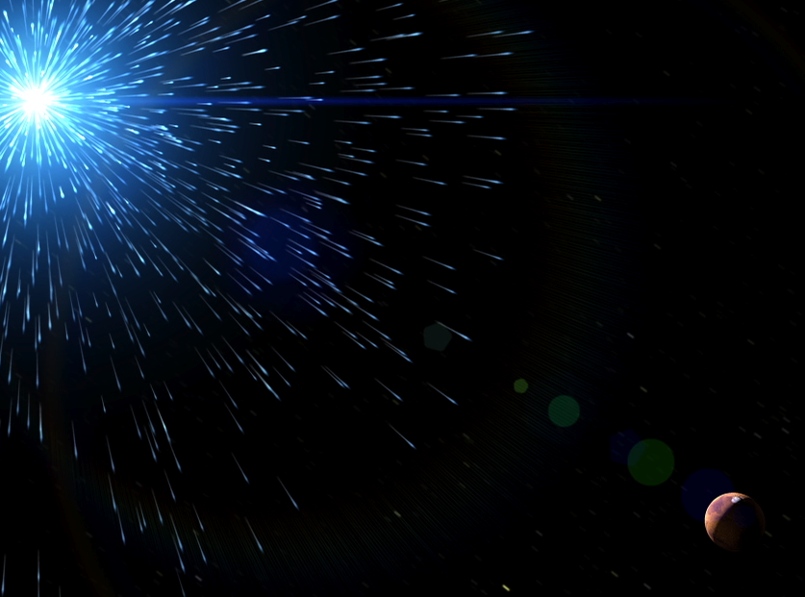
High-energy photons
(light) stream constantly
from the Sun.
Notes:
IMAGE SOURCE: NASA/GSFC/LASP
Still from MAVEN video.

Slide 18
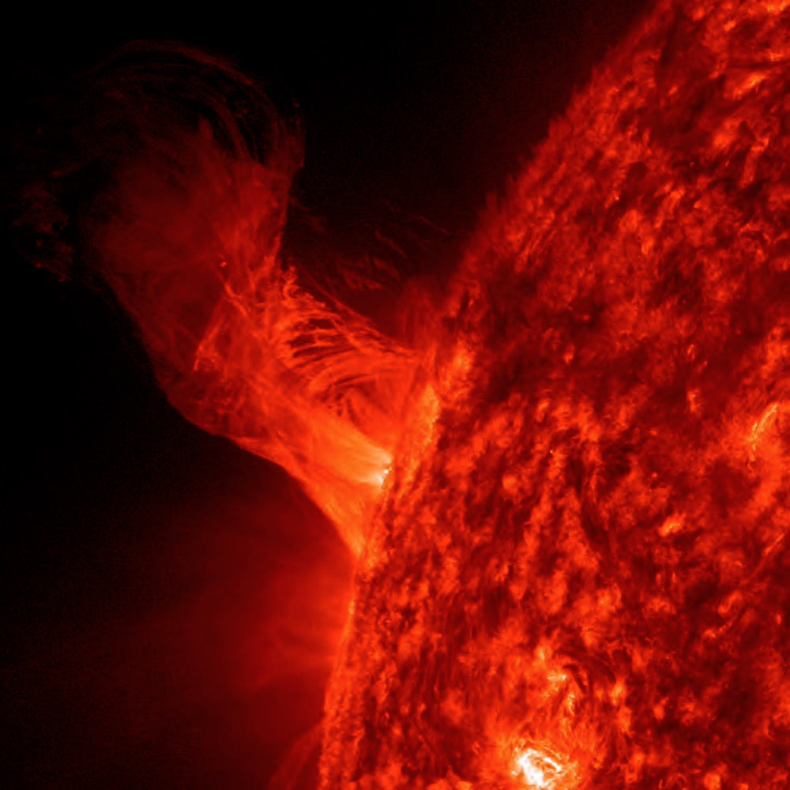
The Sun’s activity
has an impact
on planets.
Notes:
Image Credit/Source: NASA/SDO
http://www.nasa.gov/multimedia/imagegallery/image_feature_2422.html#.UmWhkXHqCUs
Additional Details:
Original Caption:
Solar Eruption
A solar eruption gracefully rose up from the sun on Dec. 31, 2012, twisting and turning. Magnetic forces drove the flow of plasma, but without sufficient force to overcome the sun's gravity much of the plasma fell back into the sun. The length of the eruption extends about 160,000 miles out from the Sun. With Earth about 7,900 miles in diameter, this relatively minor eruption is about 20 times the diameter of our planet.

Slide 19
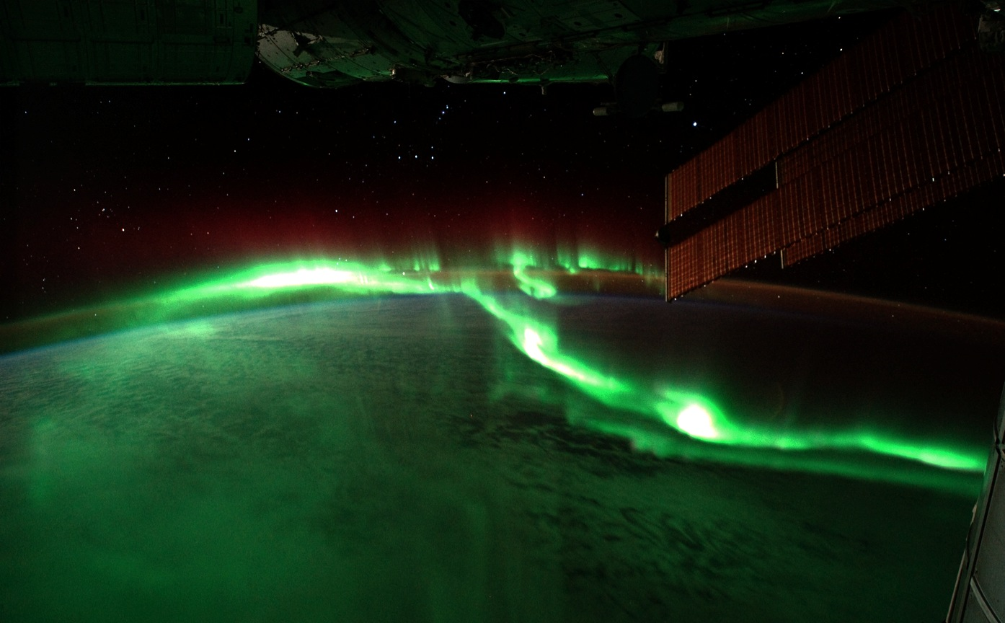
On Earth, we see “northern and southern lights” when the solar wind’s charged particles collide with gases in our atmosphere.
Notes:
IMAGE SOURCE: NASA/JSC
http://eol.jsc.nasa.gov/scripts/sseop/photo.pl?mission=ISS029&roll=E&frame=6020
Astronaut photo from the International Space Station.

Slide 20
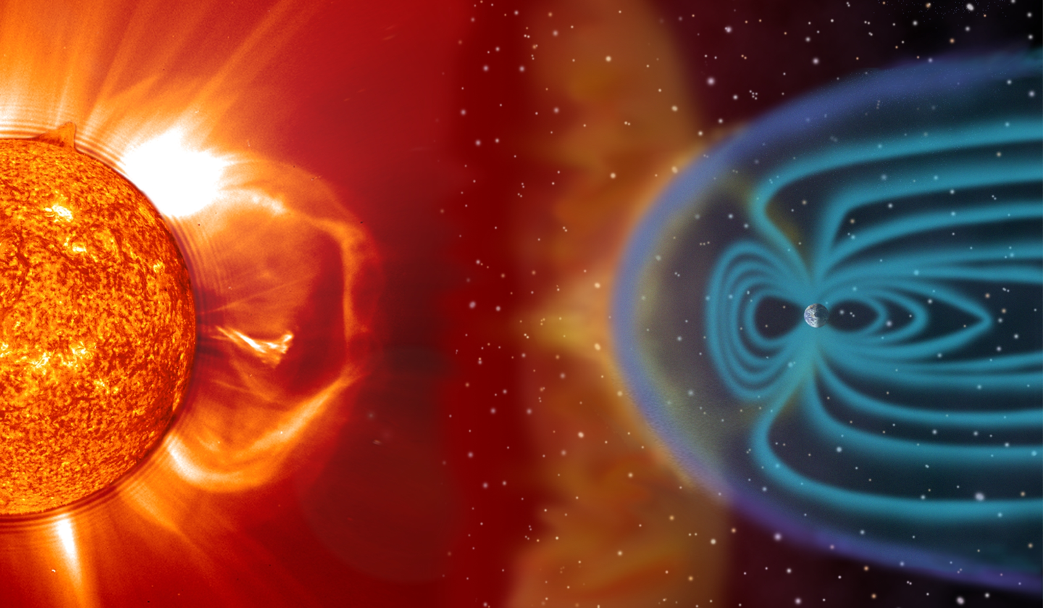
Earth’s strong magnetic field deflects many solar wind particles, preventing them from slamming into the upper atmosphere
and stripping it away.
Notes:
IMAGE SOURCE: Artist’s concept.
http://solarsystem.nasa.gov/docs/sunearth01.jpg

Slide 21
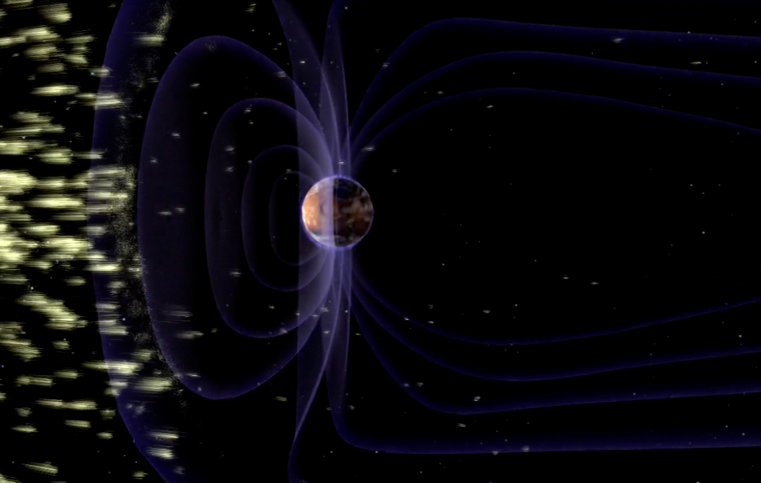
Early in its history, Mars had a strong magnetosphere
that likely protected it more from solar wind.
Notes:
Image Credit/Source: NASA/GSFC/LASP
Still from Video

Slide 22
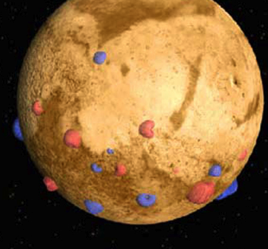
Today, Earth’s magnetic field is globally strong and
more uniform, while Mars’ is localized and scattered.
Notes:
Image Credit/Source: NASA/JPL-Caltech/GSFC
http://photojournal.jpl.nasa.gov/jpeg/PIA15953.jpg

Slide 23
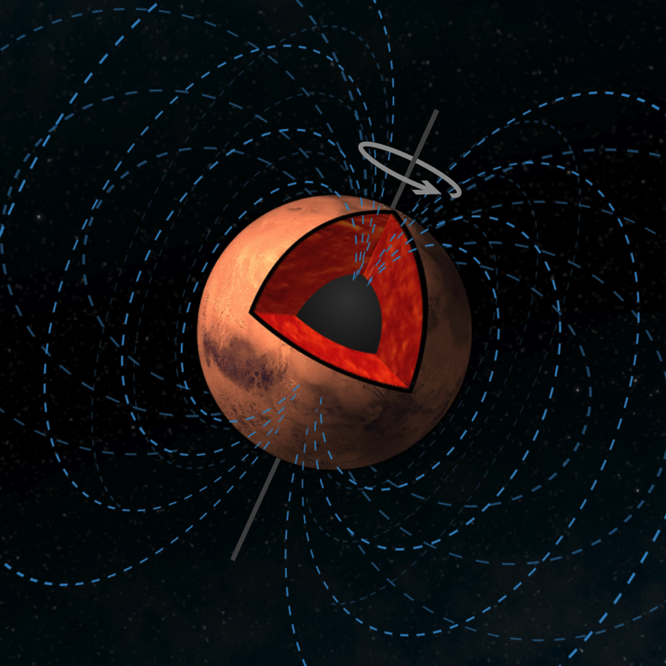
A magnetosphere emerges when
electrically charged molten material within a planet
churns in convection while the whole system rotates.
Notes:
Image Credit/Source: NASA/JPL-Caltech
Artist’s concept.

Slide 24
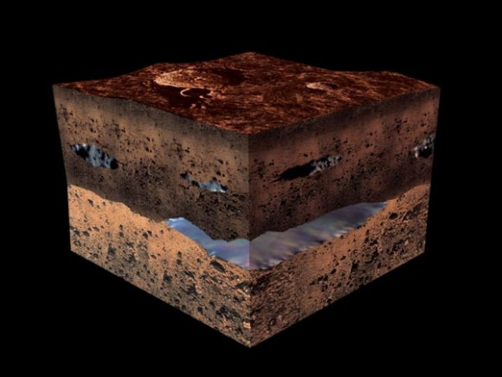
When Mars was only 500 million years old,
Mars cooled and lost its magnetic field,
radically changing the environment.
Any small life forms that may have emerged
likely died or moved underground.
Notes:
IMAGE SOURCE: ESA
Artist’s concept.

Slide 25
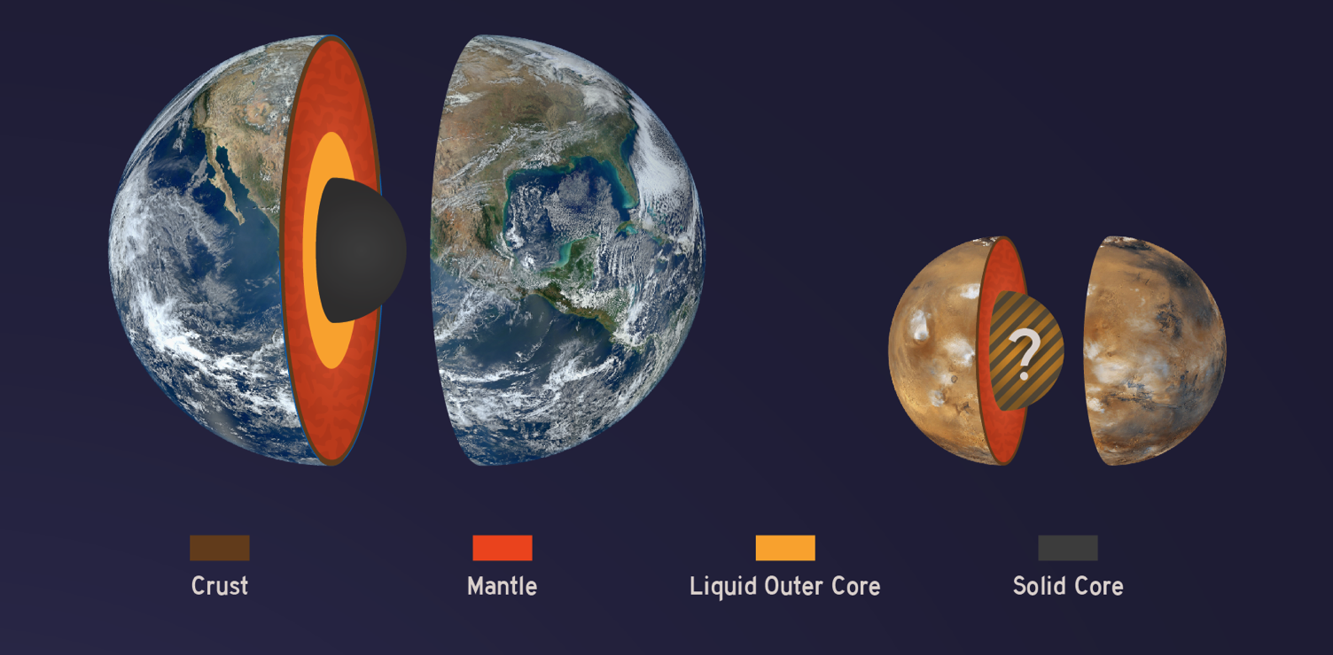
Maybe Mars simply cooled on its own due to its smaller size, turning off its internal convection cycle and magnetosphere.
Notes:
IMAGE SOURCE: NASA/JPL-Caltech
Scientists do not yet know the state of Mars’ inner core. A future Mars mission known as Insight will send a lander to study the Martian interior.

Slide 26
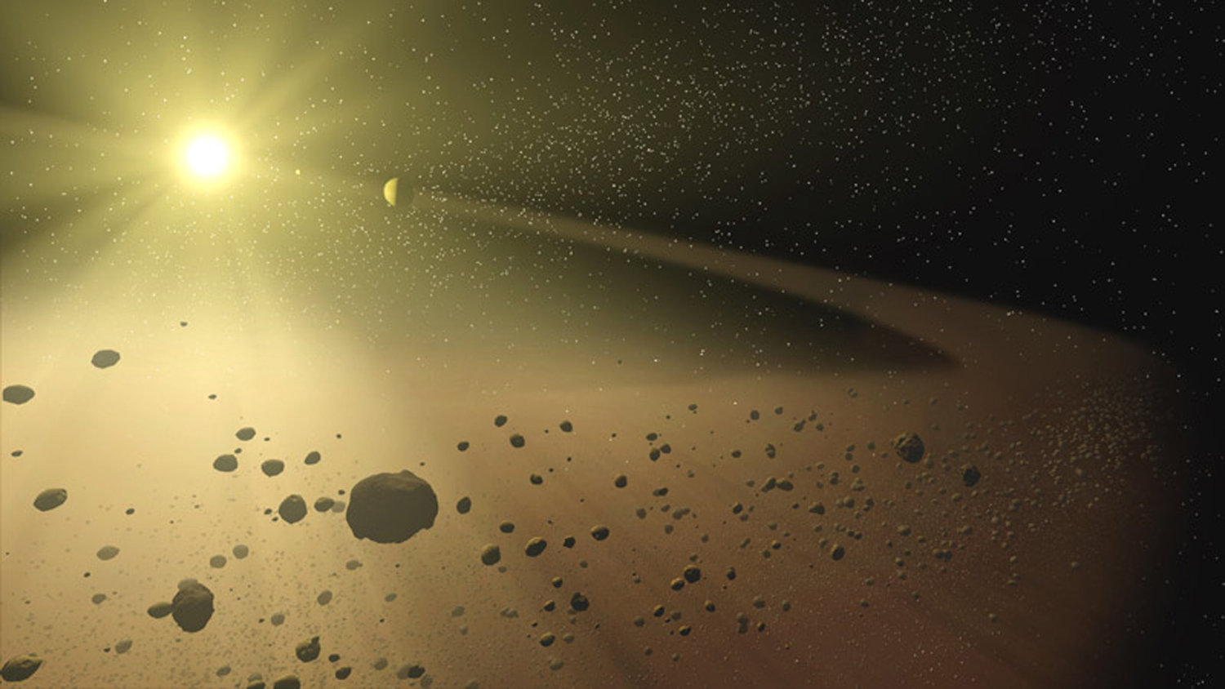
In addition to cooling, in its early days, Mars was still
vulnerable to impacts from asteroids and other bodies.
Notes:
IMAGE SOURCE: NASA/JPL-Caltech
http://www.nasa.gov/images/content/562764main_spitzer-20061010-full.jpg
Artist’s concept.

Slide 27
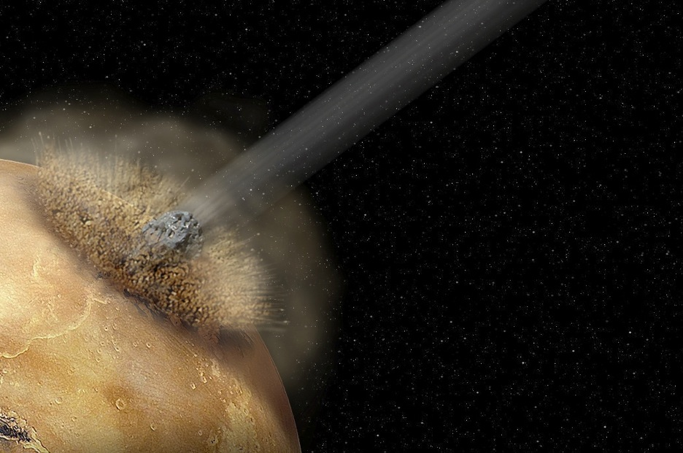
We know from studying craters on Mars that
many asteroids bombarded Mars early in its history,
potentially resulting in atmospheric loss.
Notes:
Image Source: NASA/JPL-Caltech
http://www.asc-csa.gc.ca/images/astronomie/mars/mars_atmosphere.jpg
Artist’s concept, in this case of very large and catastrophic impact.

Slide 28
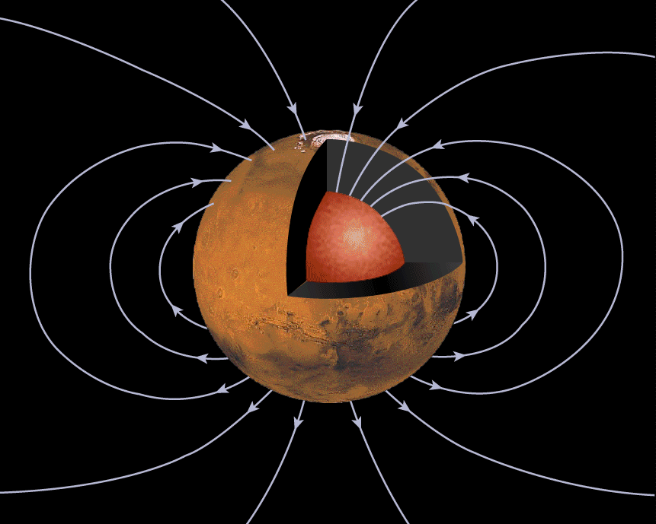
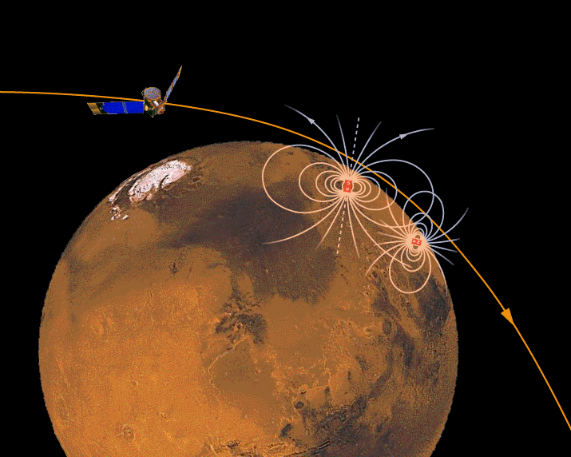
As the core and layers of Mars cooled,
its magnetic field began to disappear.
Today, only local
magnetic fields remain.
Ancient Global Magnetosphere
Local Remnants of a Magnetosphere
Notes:
IMAGE SOURCE: NASA/JPL-Caltech
http://mgs-mager.gsfc.nasa.gov/press/conn2.html
http://mgs-mager.gsfc.nasa.gov/press/conn4.html
Data collected by NASA’s Mars Global Surveyor orbiter.

Slide 29
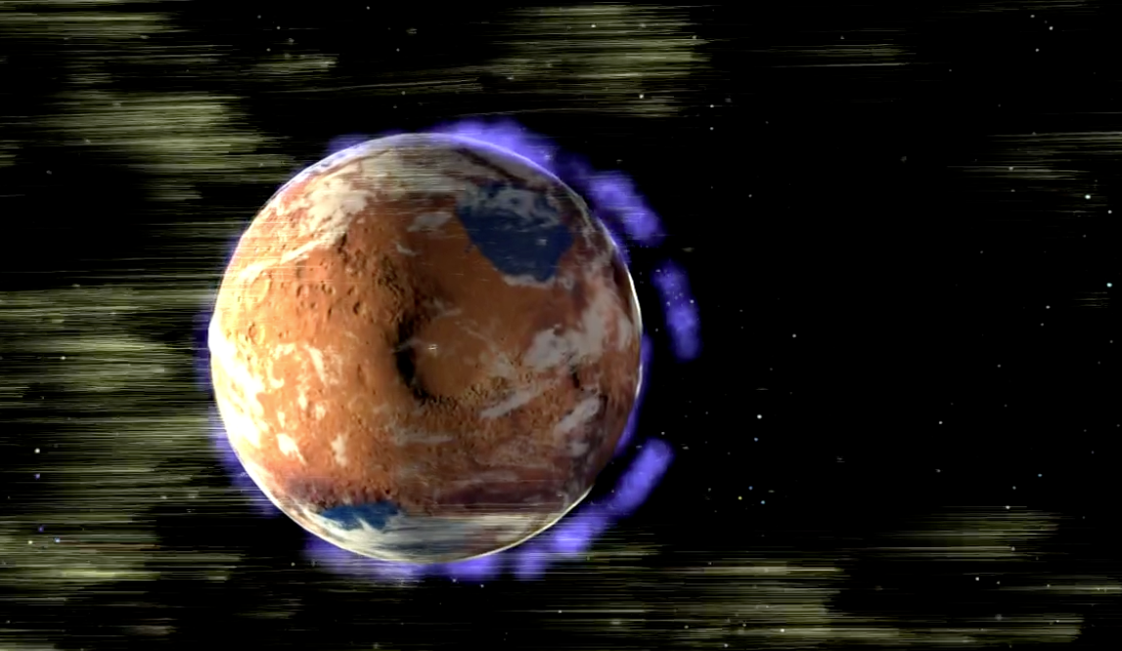
As the magnetic field turned off, the solar wind
began stripping Mars of more of its atmosphere.
Notes:
Image Source: NASA/GSFC/LASP
Still from MAVEN video.

Slide 30
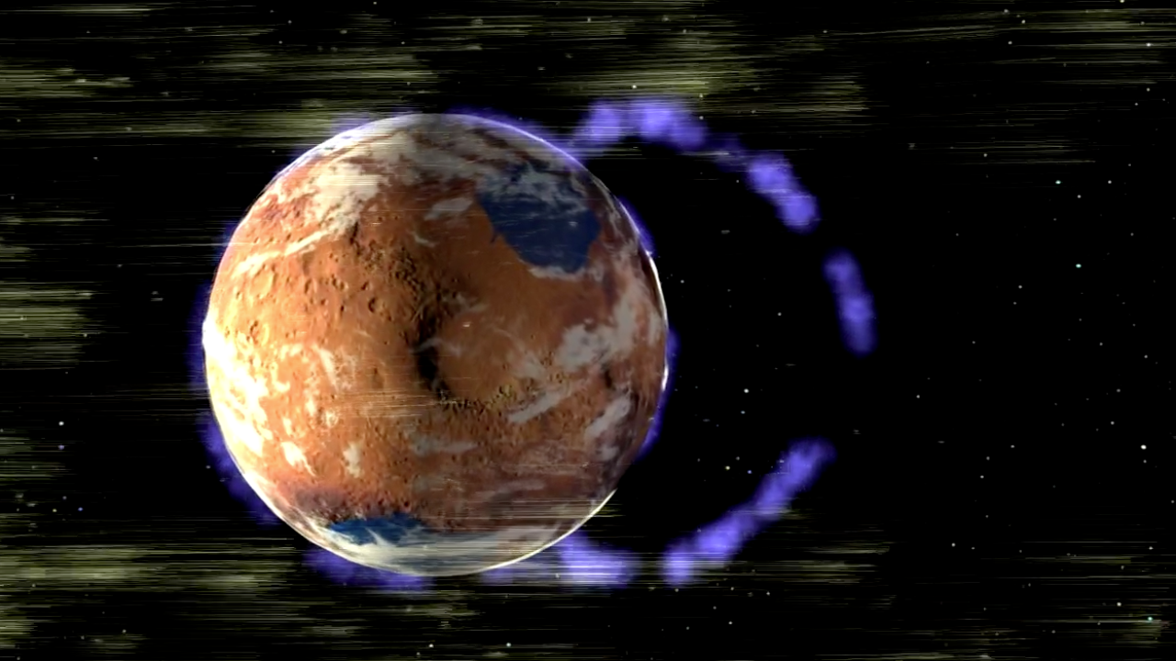
Over several hundred million years,
Mars has lost most of its atmosphere.
Notes:
Image Source: NASA/GSFC/LASP
Still from MAVEN video.

Slide 31
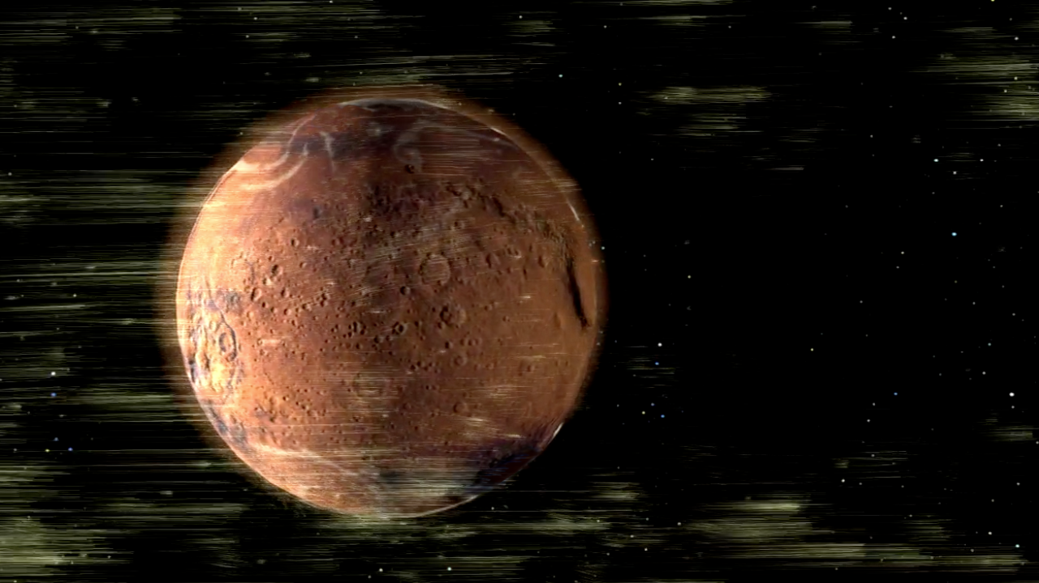
It continues to be stripped away today,
but at a much lower rate.
Notes:
Image Source: NASA/GSFC/LASP
Still from MAVEN video.

Slide 32
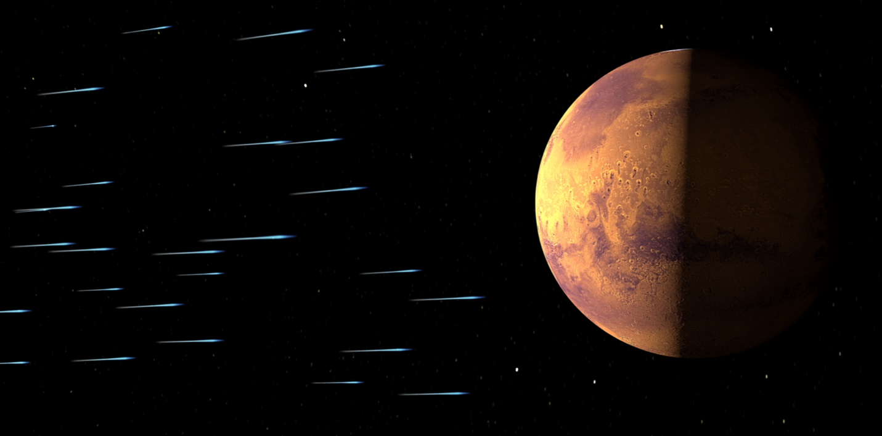
Without a strong global magnetosphere,
Mars is vulnerable.
Notes:
Image Source: NASA/GSFC/LASP
Still from MAVEN video.

Slide 33
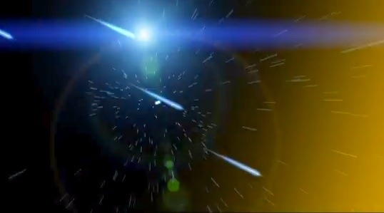
When an ultraviolet photon from the Sun crashes into
a molecule in the Martian atmosphere . . .
Notes:
Image Source: NASA/GSFC/LASP

Slide 34
. . . it knocks away an electron,
turning the molecule into an ion.
Notes:
Image Source: NASA/GSFC/LASP
Still from MAVEN video.

Slide 35
When the Sun’s magnetic field
grazes the Martian atmosphere,
ions spin around it and get carried off into space.
Notes:
Image Source: NASA/GSFC/LASP
Still from MAVEN video.

Slide 36
The Sun’s magnetic field also flings ions
right back into the Martian atmosphere.
Notes:
Image Source: NASA/GSFC/LASP

Slide 37
Those ions zoom back into the atmosphere
going over 2 million miles per hour!
Like hitting balls in a game of pool, they slam into
one atom after another, flinging atoms everywhere.
Notes:
Image Source: NASA/GSFC/LASP
Still from MAVEN video.

Slide 38
Some are knocked into space (“sputtered”).
Over billions of years, this sputtering
caused a lot of atmospheric loss.
Notes:
Image Source: NASA/GSFC/LASP
Still from MAVEN video.

Slide 39
By measuring the rate of escape to space today,
scientists can infer how Mars’ environment
changed through its ~4.5 billion year history.
Notes:
IMAGE SOURCE: NASA/JPL-Caltech Artist’s concept of an ancient Mars with a thicker atmosphere and water (left) and modern Mars, arid with a thin atmosphere (right).

Slide 40
What we learn from MAVEN may help us understand
early conditions favorable to life and how long they lasted.
Notes:
Image Source: NASA/JPL-Caltech Artist’s concept of ancient Mars and an imaged hot springs environment.

Slide 41
MAVEN launches on an Atlas V 401 rocket
from Cape Canaveral Air Force Station, Florida,
between November 18 & December 7, 2013.
Notes:
Image Source: NASA/JPL-Caltech
http://mars.jpl.nasa.gov/mro/images/mrolaunch.jpg

Slide 42
MAVEN carries with it the names of ~100,000 people,
artwork from children all over the world, and
haiku poetry submitted in an online contest.
Notes:
Image Source: NASA/GSFC/LASP

Slide 43
MAVEN is the length of a school bus:
~11 meters (37 feet) long.
Notes:
Image Source: orbiter: NASA/GSFC/LASP school bus: as altered - NASA/JPL-Caltech

Slide 44
The orbiter weighs
as much as
an SUV loaded
with a family:
2,550 kg
(~5,622 lb)
Notes:
Image Source: Orbiter: NASA/GSFC/Lockheed/LASP Family in SUV: NASA/JPL-Caltech (has image releases)

Slide 45
During launch, MAVEN
Is protected in the rocket’s “nose cone” (its fairing).
Shortly after launch,
the fairing drops away, making way for MAVEN to be released on its journey through space to Mars.
Notes:
http://lasp.colorado.edu/home/maven/files/2013/06/MAVEN-Payload_Fairing.jpg

Slide 46
For about 10 months after launch,
MAVEN will cruise from Earth to Mars.
Mars at Launch
Earth
at Launch
MAVEN
Cruise
Earth
at Arrival
Mars at Arrival

Slide 47
Mars Orbit Insertion on ~September 22, 2014
captures MAVEN into orbit around Mars.
Then, it takes about a month to go from capture to final orbit,
deploy the booms, and test instruments and the spacecraft’s alignment.
Notes:
Image Source: NASA/JPL-Caltech/LASP

Slide 48
MAVEN will fly in an elliptical orbit above Mars,
measuring all relevant parts of Mars’ upper atmosphere.
CLOSEST TO MARS
(Periapsis: 150 km/93 mi)
FARTHEST FROM MARS
(Apoapsis: 6200 km/3900 mi)

Slide 49
CLOSEST TO MARS
(Typical Periapsis: 150 km/93 mi)
At MAVEN’s closest approach,
it is 3 times closer to Mars than the
International Space Station is to Earth.
Notes:
http://spaceflight.nasa.gov/gallery/images/shuttle/sts-110/lores/sts110-730-031.jpg

Slide 50
Typical Periapsis
150 km/93 mi
Five times on its closest approach,
MAVEN will perform “deep dips”
into the Martian atmosphere,
coming as close as
125 km (78 mi).

Slide 51
MAVEN will study the atmosphere just after
“solar maximum,” a time when the sun is most active.
MAVEN Primary Mission
During this time, the Sun’s activity reveals processes
like those billions of years ago when our star was young.

Slide 52
In addition to understanding atmospheric changes and loss
in general, MAVEN will also take measurements
when events such as solar flares occur.

Slide 53
A year of MAVEN orbits
will provide data on
all key regions of the
upper Martian atmosphere
and magnetosphere.
Mars
MAVEN Orbits
Solar Wind
REGIONS OF THE MAGNETOSPHERE
Magnetosheath
Magnetic Pile-up Region
Wake

Slide 54
For making discoveries,
MAVEN science instruments come in 3 packages.
LPW (2)
SWEA
SWIA
MAG (2)
SEP
SEP
Articulated Payload Platform: (IUVS/STATIC/NGIMS)
Neutral Gas & Ion
Mass Spectrometer
Particles and Fields
Remote Sensing
6 instruments characterize
the Sun and solar wind.
1 instrument studies global
characteristics of the upper atmosphere & ionosphere.
1 instrument measures
the composition & isotopes
of neutral gases and ions.

Slide 55
MAVEN Instrument “Glamour Shots”
1
2
3
4
5
6
7
8
Particles and Fields
Remote Sensing
Solar Wind Electron Analyzer (SWEA)
Solar Wind Ion Analyzer (SWIA)
SupraThermal And Thermal Ion Composition (STATIC)
Solar Energetic Particle (SEP)
Magnetometer (MAG)
Langmuir Probe and Waves (LPW)
Imaging Ultraviolet Spectrometer (IUVS)
8. Neutral Gas and Ion Mass Spectrometer (NGIMS)
Spectrometer
Notes:
http://lasp.colorado.edu/home/maven/files/2012/02/SWEA5_full.jpg
http://lasp.colorado.edu/home/maven/files/2012/02/SWIA5_full.jpg
http://lasp.colorado.edu/home/maven/files/2012/02/STATIC5_full.jpg
http://lasp.colorado.edu/home/maven/files/2011/03/SEP_full.jpg
http://lasp.colorado.edu/home/maven/files/2011/03/MAG_full.jpg
http://lasp.colorado.edu/home/maven/files/2013/04/MAVEN-Remote-Sensing-Package.jpg
http://lasp.colorado.edu/home/maven/files/2013/04/NGIMS_full_integrated.jpg
Particles and Field (P&F) Package
Solar Wind Electron Analyzer (SWEA) – measures solar wind and ionospheric electrons
Solar Wind Ion Analyzer (SWIA) - measures solar wind and magnetosheath ion density and velocity
SupraThermal And Thermal Ion Composition (STATIC) - measures thermal ions to moderate-energy escaping ions
Solar Energetic Particle (SEP) - determines the impact of SEPs on the upper atmosphere
Langmuir Probe and Waves (LPW) - determines ionospheric properties and wave heating of escaping ions and solar extreme ultraviolet (EUV) input to atmosphere
Magnetometer (MAG) - measures interplanetary solar wind and ionospheric magnetic fields Remote Sensing (RS) Package
Imaging Ultraviolet Spectrometer (IUVS) - measures global characteristics of the upper atmosphere and ionosphere
Neutral Gas and Ion Mass Spectrometer (NGIMS) Package
Measures the composition and isotopes of neutral gases and ions

Slide 56
By scanning low and high in the upper atmosphere,
MAVEN instruments will measure how the composition
of the atmosphere varies with altitude.

Slide 57
MAVEN will compare its measurements with data collected
by the Curiosity rover on the lower atmosphere.
Notes:
Image Credit:
Curiosity rover: NASA/JPL-Caltech/MSSS
Composition: NASA/JPL-Caltech/GSFC original: http://photojournal.jpl.nasa.gov/catalog/PIA16460

Slide 58
MAVEN and Curiosity measure the amounts of different kinds
of atoms, ions, and isotopes to calculate escape rates.
Hotter, lighter particles escape much faster.
Argon especially helps determine atmospheric loss.
Notes:
CREDIT/SOURCE: NASA/jPL-Caltech http://photojournal.jpl.nasa.gov/catalog/PIA16818
Speaker’s Notes:
Basics:
--isotopes are heavier versions of an element
--hotter, lighter particles escape faster
--by comparing ratios of lighter and heavier atoms, ions, and isotopes in the atmosphere today, and comparing that with estimated measurements of ratios in ancient times, it is possible to understand how much of each has been lost
Chart Explanation:
--how to figure out how how Mars transformed from a once water-rich planet, more like our own, into today's drier, colder and less-hospitable world.
--before Curiosity, the argon ratio in Martian meteorites was the best measure of how much atmosphere Mars has lost since the planet's wetter, warmer days billions of years ago
--if Mars held onto all of its atmosphere and its original argon, its ratio of the gas would be the same as that of the sun and Jupiter
--those bodies have so much gravity that isotopes can't preferentially escape, so their argon ratio -- which is 5.5 -- represents that of the primordial solar system
--argon makes up only a tiny fraction of the gas lost to space from Mars
--it is special because it's a noble gas
--that means the gas is inert, not reacting with other elements or compounds, and therefore a more straightforward tracer of the history of the Martian atmosphere. --it is the clearest signature of atmospheric loss because it's chemically inert and does not interact or exchange with the Martian surface or the interior.
--this image shows the ratio of the argon isotope argon-36 to the heavier argon isotope argon-38, in various measurements
--the point farthest to the right designates a new (2013) measurement of the ratio in the atmosphere of Mars, made by the quadrupole mass spectrometer in the Sample Analysis at Mars (SAM) suite of instruments in NASA's Curiosity Mars rover
--for comparison, the previous measurement at Mars by the Mars Viking project in 1976 is shown also
--the SAM result is at the lower end of the range of uncertainty of the Viking data, but compares well with ratios of argon istotopes from some Mars meteorites
--the value determined by SAM is significantly lower than the value in the sun, Jupiter and Earth, which implies loss of the lighter isotope compared to the heavier isotope over geologic time.
--the argon isotope fractionation provides clear evidence of the loss of atmosphere from Mars.
--the above is an example of how to determine atmospheric loss;
--to find out how much water specifically has been lost to space, MAVEN can measure amounts of hydrogen and deuterium (heavy version of hydrogen)
-- familiar example: H2O: two atoms of hydrogen joined to an oxygen atom = water molecule
--less often: deuterium substitutes for hydrogen atom
--hydrogen escapes faster and more often because it is lighter than deuterium
--thus, over time, the Martian atmosphere is stripped of more hydrogen vs. deuterium, so the proportion of deuterium rises
--MAVEN can measure the ratio today vs. the original ratio to see how much hydrogen – and thus water – has been lost

Slide 59
MAVEN communications and power assets
are also key components of the orbiter.
Electra (behind)
Fixed High Gain Antenna
“Gull-Wing” Solar Arrays
Notes:
Image Credit: NASA/GSFC/LASP
Speaker’s Notes:
Electra is a telecommunications package that acts as a communications relay and navigation aid for Mars spacecraft. It is a software package used to allow a rover or lander to send data to an orbiter, which then transmits the data to Earth. It increases the amount of data that can be returned by two or three orders of magnitude.

Slide 60
After its primary science mission, MAVEN can also support
current and future Mars landers and rovers
by relaying data back to Earth.
Notes:
Image Credit: NASA/GSFC/JPL-Caltech

Slide 61
Mission Success:
It takes a team of talented people!
Notes:
Image Credit for Collage: NASA/GSFC/KSC/LMA

Slide 62
lasp.colorado.edu/maven
www.nasa.gov/maven
Twitter & Facebook: MAVEN2Mars

Slide 63
QUESTIONS ABOUT MAVEN?

